Slide 1
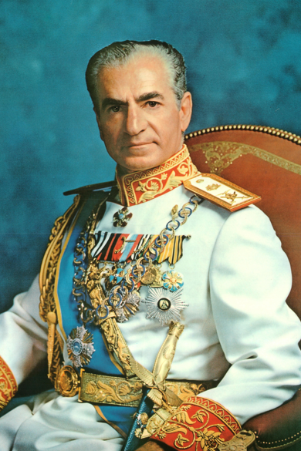
The Shah of Iran
By Ali, Maddie, Nate, Raymond, Brandon, and Mariam

Slide 2
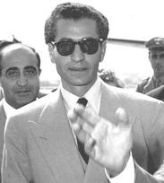
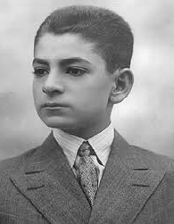
About the Shah of Iran
Mohammad Reza Shah Pahlavi was born in Tehran on October 26, 1919
He was the eldest son of Reza Shah
The Shah went to school in Switzerland

Slide 3
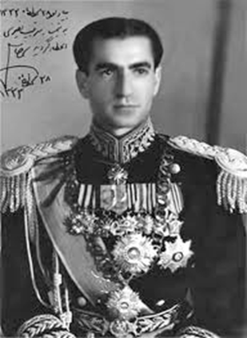
About the Shah of Iran
He returned to Iran in 1935, and enrolled in a Tehran military school
The Shah graduated in 1938

Slide 4
About the Shah of Iran
In 1939 he married a sister of Faroq I, king of Egypt
The couple divorced in 1949
Mohammad Reza married two more times
1950 he was married to Soraya Esfandiari
In 1959 with Farah Diba

Slide 5
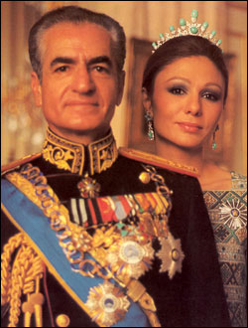
Farah Pahlavi (Farah Diba)
Farah Pahlavi was born October 14th, 1938
Pahlavi married the Shah on December 21st, 1956
The Shah’s 3rd wife

Slide 6
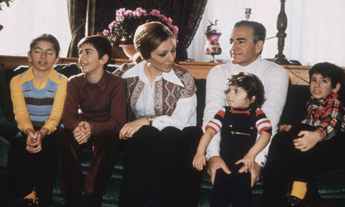
Farah Pahlavi
Because of her interest in the arts, many cultural movements and paintings were given to the Iranian arts
Pahlavi gave birth to four children
She lived in exile with the Shah in France after the Islamic Revolution in 1979

Slide 7
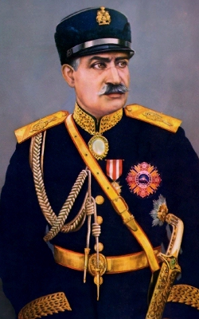
Reza Shah
Reza Shah the father of Mohammad Reza Pahlavi
Reza Shah was the shah from December 15th, 1925
He was forced to give up his power on September 16^{th,} 1941

Slide 8
Early struggles
During World War II, Reza Shah had friendly relations with Germany
This was highly concerning to Britain and the USSR
In 1941 the two countries invaded Iran
They both occupied large areas of the country

Slide 9
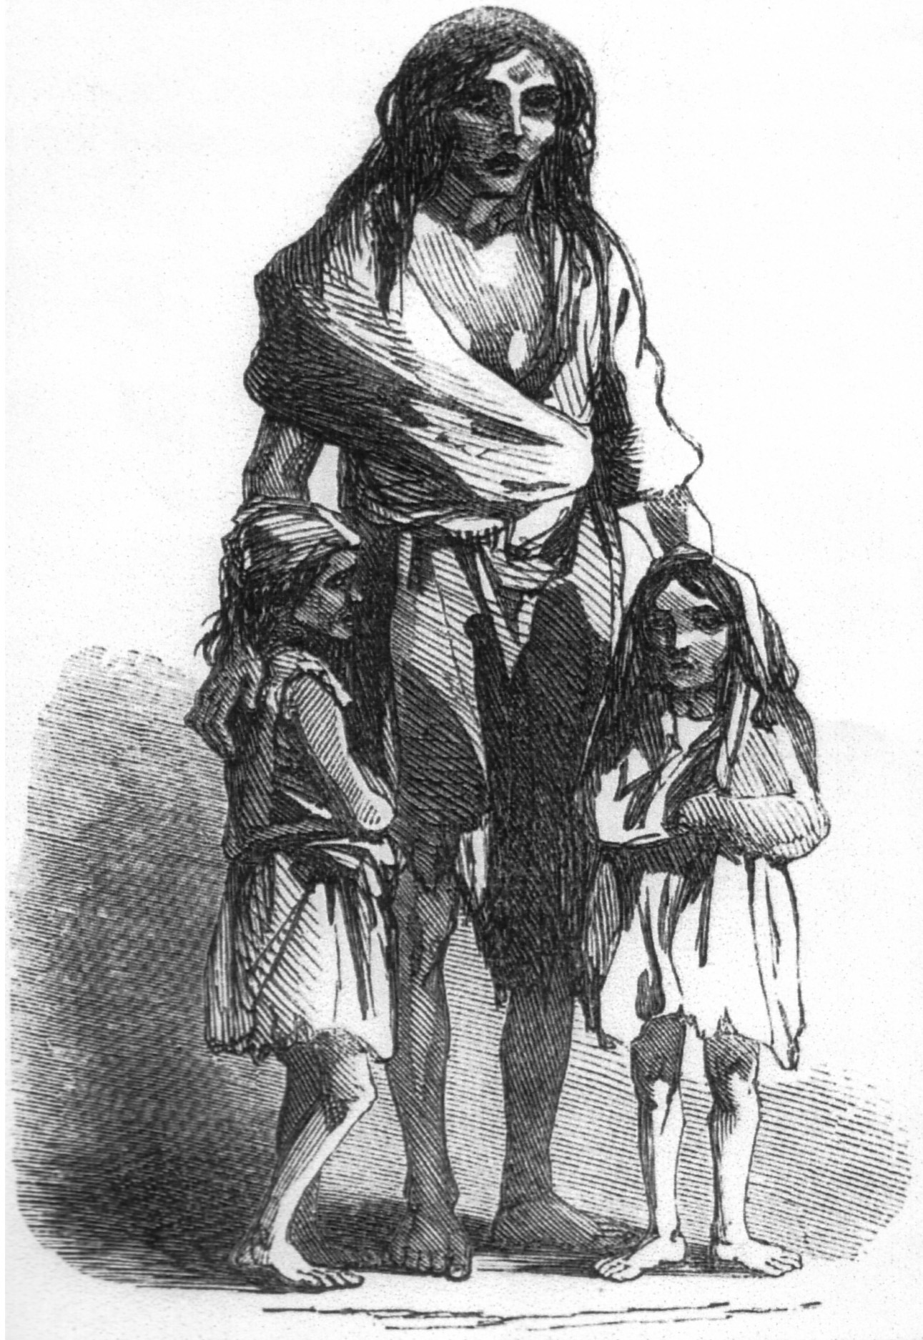
Early Struggles
They forced Reza Shah to give up his position of power
Since there was no suitable alternative, Mohammad Reza was permitted to assume the throne
The new Shah began his reign during a time of famine and political and social disarray

Slide 10
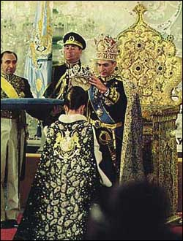
When and how did the Shah of Iran (Mohammad Reza Pahlavi) come to power?
The Shah of Iran (Mohammad Reza Pahlavi) was in power in 1941-1979.
He replaced his father, Reza Shah, on September 16, 1941.
This was before his 22nd birthday

Slide 11
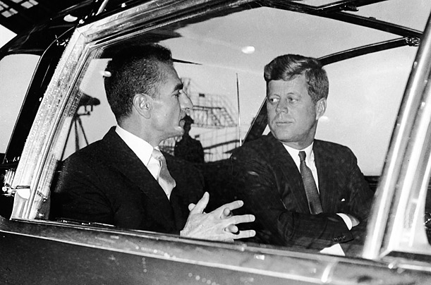
What was the U.S.’s role in helping him come to power?
People criticized the Shah of Iran for violating the terms of their constitution
This led to limits on royal power and subservience to the U.S.
The U.S. thought of the Shah as an ally

Slide 12
What kind of Government did the Shah lead?
The government under Mohammad Reza Pahlavi was a monarchy
A monarchy is a system of government where the rule of a country is passed down through the family

Slide 13
What kind of government did the Shah lead?
The ruler has the most control but shares some with the parliament
The Shah took away all the power that the parliament had and gave the Shah all control

Slide 14
What kind of government did the Shah of Iran lead?
The rule of the Shah of Iran turned into a dictatorship
Dictatorship: a form of government in which a powerful ruler has absolute control. Control is usually achieved by force

Slide 15
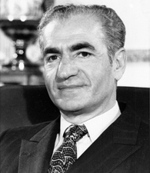
Why was the Shah liked?
Introduced the White Revolution, which was intended to transform Iran into a global power
He did this by nationalizing certain industries and granting women suffrage
The Shah created a program for free of charge nourishment for school children

Slide 16
Why was the Shah disliked?
The Shah decreed that all Iranians must become a part of the Rastakhiz Party
There were reports of oppression, extravagance, brutality, and corruption
The Shah paid $100 million to put on a festival to celebrate the 250th year of Iranian monarchy, when there were suffering villages nearby

Slide 17
When and how did the Shah lose power?
The Shah lost power in 1979
The Shah’s program of rapid modernization and oil-field development initially made him very popular
However, his autocratic style and the unequal distribution of Iran's new oil wealth, increased opposition
In 1979 Pahlavi was forced into exile

Slide 18
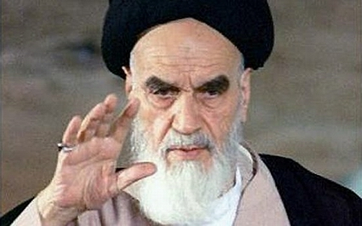
Who took over after the Shah lost power?
Islamic Republic of Iran was established under the supreme leadership of Ayatollah Ruhollah Khomeini
He worked to usurp Mohammad Reza Pahlavi

Slide 19
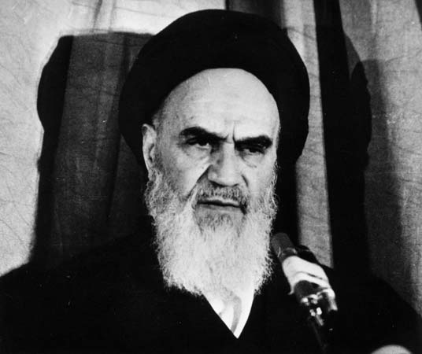
Ayatollah Ruhollah Khomeini
Khomeini wanted the Shah removed for his associations with the west
After the revolution Khomeini was named religious and political leader of Iran
This name remained for life

Slide 20
Bibliography
Pahlavi, Mohammad Reza Shah." Britannica Concise Encyclopedia. 2011. eLibrary. Web. 20 Sept. 2013.
“Historic Personalities of Iran: Mohammad Reza Shah Pahlavi.” Iran Chamber Society, n.d. Web. 23 Sept. 2013
“Timeline: US-Iran Ties.” BBC News. BBC, 16 Jan 2009. Web. 23 Sept. 2013.
“Mohammad Reza Shah Pahlavi”. Encyclopedia Britannica Online. Encyclopedia Britannica Inc., 2013. web. 24 Sept. 2013

