Slide 1
Islam and its effect on Iran
Nathaniel Stevens, Evan Cross, Carissa Liau, Christian Espinoza, Kimberly Ong, Helen Bundy

Slide 2
Major Beliefs
Belief of one god
Angels are honored and real creatures
Believed in Day of judgment
People will be restored to life for god’s judgment according to their beliefs and deeds
Believe in prophets and messengers of god

Slide 3
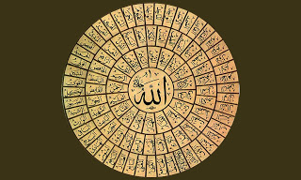
Major figures of Islam
http://1.bp.blogspot.com/-U1geCyTkZEE/Tp7MmS0s_FI/AAAAAAAAAsU/kgS7IMadmhk/s320/allah__s_name_wallpaper_050_by_almubdi-d38qo4d.jpg
Allah:
Islam’s God, ruler of Heaven and Earth.
He is all knowing, all powerful, and will be there “when nothing else remains”

Slide 4
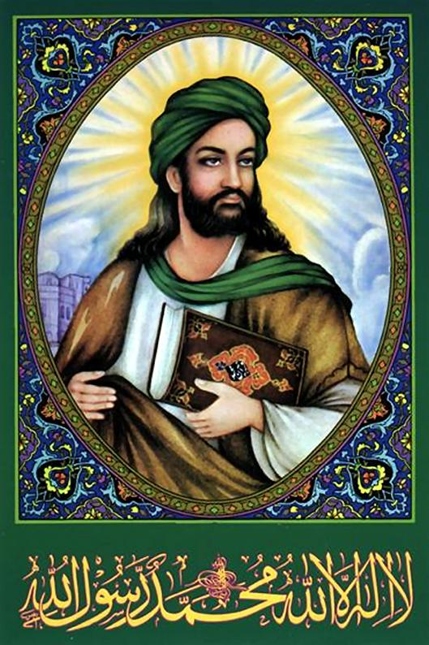
Major figures of Islam
http://actforamerica.files.wordpress.com/2011/09/muhammad041.jpg
Muhammad:
The last of the prophets, completed teachings of Islamic belief
Supposed founder of Islam
Dictated some of the first “words of god” to followers of Islamic belief

Slide 5
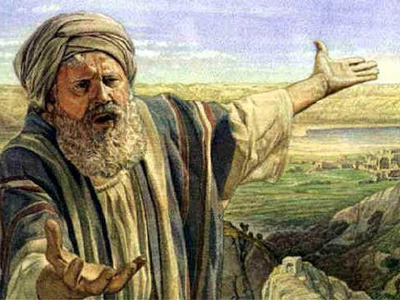
Major figures of Islam
http://www.rtvbodegraven.nl/userfiles/image/Kerken/In%20Waddinxveen/De%20Hoeksteen,%20Esdoornlaan%202/De%20Islam%20en%20de%20landbelofte%20voor%20Israel,%203%20maart%202010%20(Abraham).JPG
Abraham
One of seven prophets
Notable “hernif” (one who knows there is only one god)

Slide 6
Popularity of Islam
Strong Faith to follow
Singular god to worship
Prevalent and honest principals
Motivation to reach Paradise
Consistent ideology and cohesive history
About 1.6b people worldwide (23% of the world)

Slide 7
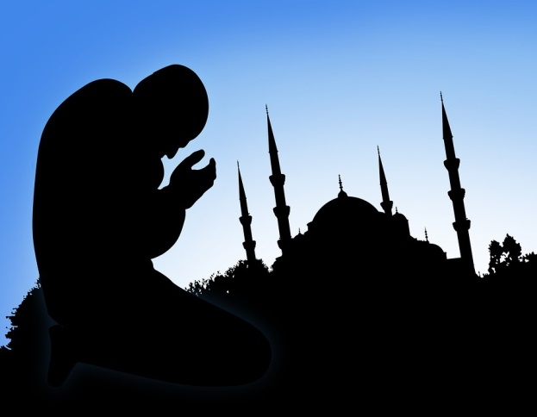
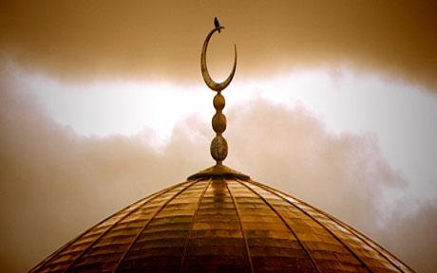
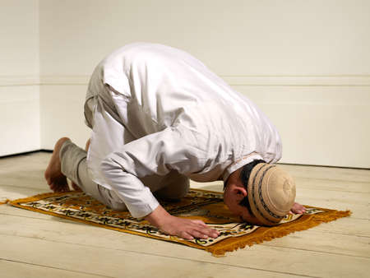
Benefits of Beliefs
“Liberates” a person from fear and sin
Submission to the will of god frees from superstition
Fills mind with truth and knowledge
Allows a person to “truly” experience God’s love
God promises Paradise to the believer
Place of eternal bliss and happiness
Establishes connection with ‘the creator’ for many
http://muslimwriters.org/wp-content/uploads/2012/11/muslim-praying.jpg
http://i.telegraph.co.uk/multimedia/archive/00798/regents-park-mosque_798486c.jpg
http://3.bp.blogspot.com/--zKwsj2VdeQ/TWvgdPohKuI/AAAAAAAABzs/rlZVfXATnAs/s1600/n00021501-b.jpg

Slide 8
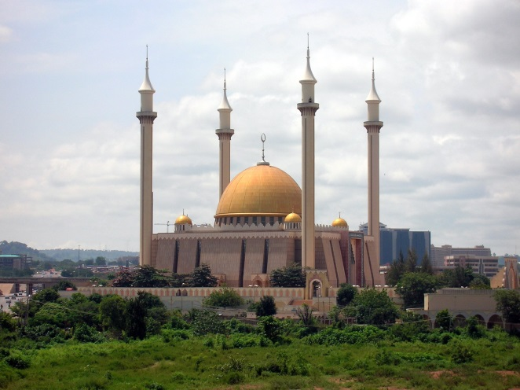
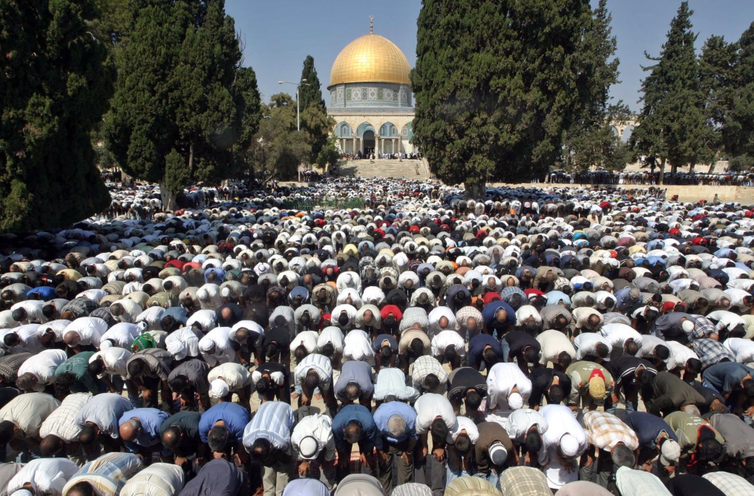
Rituals of Islam
Pray five times a day to talk to god
Common place of worship in mosques
Do not eat pork
Not allowed to eat with left hand
Hijabs are required of women
Pilgrimage to Mecca
http://upload.wikimedia.org/wikipedia/commons/d/d4/AbujaNationalMosque.jpg
http://www.nato.int/docu/review/2005/issue4/graphics/contents/i4_a2_1b.jpg

Slide 9
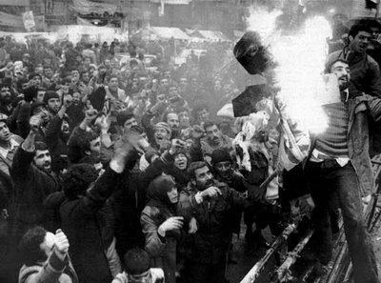
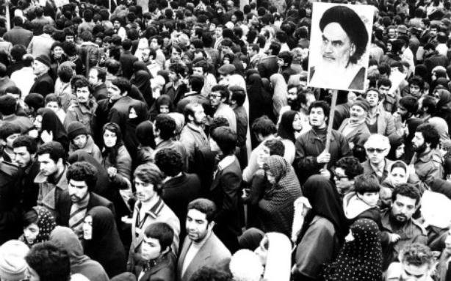
Role of Islam in the Revolution
The Shaw identified closely with the West
Went against Muslim traditions
Tried to modernize Iran
Fueled many supporters and dignitaries
Provided people with a reason to die/fight for their cause
Played a pivotal role in ideologies and motivations of supporters
http://3.bp.blogspot.com/_QfVWU-2pVL4/SeTOaNwAGyI/AAAAAAAAFVo/xc4qG-ooy0k/s400/Iran_30th_retro_07_483670a.jpg
http://cdn.theatlanticwire.com/img/upload/2011/08/iranian-revolution-reuters/large.jpg

Slide 10
Footage from the Revolution

Slide 11
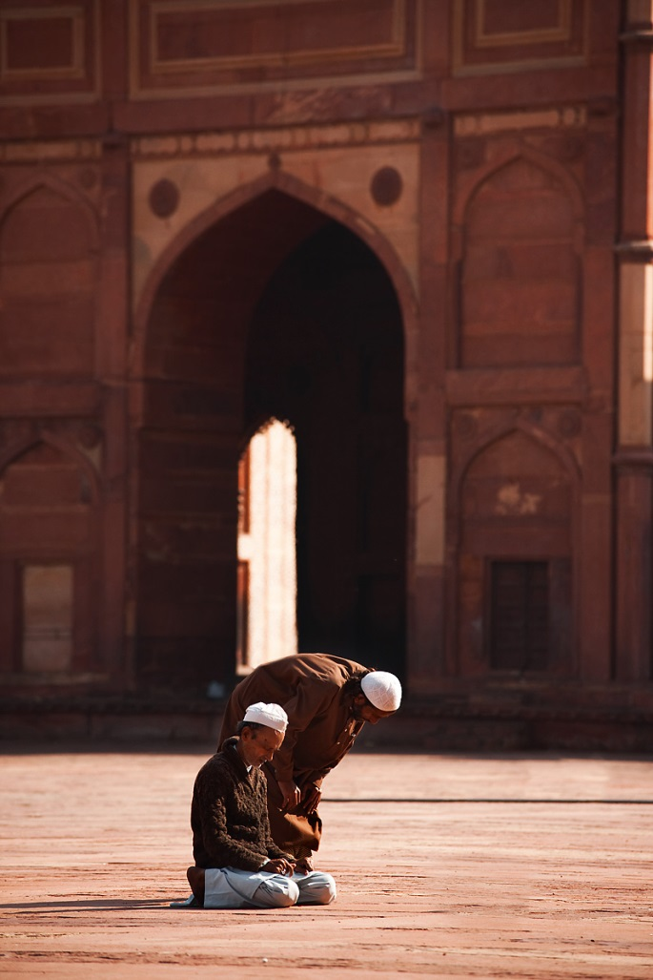
Distinguishable Branches
The Sunnis
85% of Muslims
“Guardians of orthodoxy and tradition”
Very traditional
The Shi’ites
Believe in figures like Mahdi to restore faith and purity
Do not trust traditional texts (Qur’an)
Sufis
More concerned about spiritual matters
Mystic core beliefs and more abstract views
http://www.dailytravelphotos.com/images/2009/091223_fatehpur_sikri_jama_masjid_courtyard_muslim_men_praying_travel_photography_MG_7951.jpg

Slide 12
Important Holidays
Ramadan
Annual month of fasting
Muharranm
One of 4 sacred months
Muwlid al-Nabi
Celebration of the birthday of Muhammad
Eid al-Fitr
Marks the end of Ramadan; A very large portion of food is eaten
Eid al-Adha
Honors the deeds and sacrifices of Abraham

Slide 13
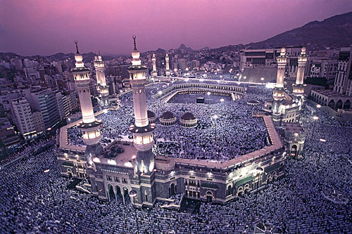
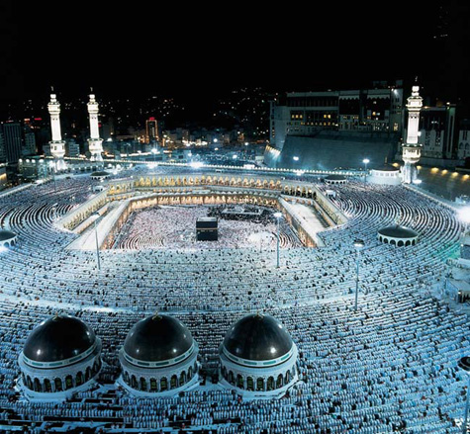
Mecca
City in Saudi Arabia
Pilgrimage made by all (able) muslims
Hajj must happen at least once in lifetime
15 million visit annually
Is necessary to fulfill life as a muslim if financially able
http://shedexpedition.com/wp-content/uploads/2013/03/mecca.jpg

Slide 14
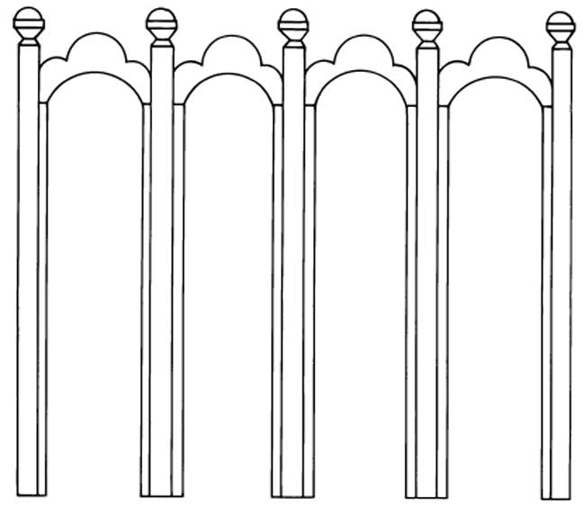
Five Pillars of Islam
Shahadah
No god but Allah
Salah
Ritual prayer five times a day
Sawm
Fasting during Ramadan
Zakat
Giving 2.5% of savings to the poor
Hajj
Pilgrimage to Mecca (at least once/if able)
http://www.waupun.k12.wi.us/Policy/other/dickhut/religions/Images/5Pillars.jpg

Slide 15
Bibliography
"Adhan." Wikipedia. Wikimedia Foundation, 24 Sept. 2013. Web. 23 Sept. 2013. <http://en.wikipedia.org/wiki/Adhan>.
"Allah." Wikipedia. Wikimedia Foundation, 20 Sept. 2013. Web. 24 Sept. 2013. <http://en.wikipedia.org/wiki/Allah>.
"Historic Personalities of Iran: Mohammad Reza Shah Pahlavi." Historic Personalities of Iran: Mohammad Reza Shah Pahlavi. N.p., n.d. Web. 24 Sept. 2013. <http://www.iranchamber.com/history/mohammad_rezashah/mohammad_rezashah.php>.
"Iranian Revolution." Iranian Revolution. N.p., n.d. Web. 23 Sept. 2013. <http://novaonline.nvcc.edu/eli/evans/his135/Events/Iran79.htm>.
"Islamic Holidays." - ReligionFacts. N.p., n.d. Web. 23 Sept. 2013. <http://www.religionfacts.com/islam/holidays.htm>.
"Muslim Beliefs." – Haq Islam. N.p., n.d. Web. 24 Sept. 2013. <http://www.haqislam.org/muslim-beliefs/>.
"Muslim Beliefs." Beliefs of Islam. N.p., n.d. Web. 24 Sept. 2013. <http://www.religionfacts.com/islam/beliefs.htm>.
"Prophets of Islam." About.com Islam. N.p., n.d. Web. 24 Sept. 2013. <http://islam.about.com/od/prophets/p/prophets.htm>.

